Slide 1

2
Business Environment

Slide 2
Definition :
Business Environment
Environment refers to all external factors which have a bearing on the functioning of the business.
It refers to those aspects of the surroundings of business enterprise and circumstances of business unit which affect or influence its activities and operations and decides its effectiveness.

Slide 3

Micro-Environment
According to Charles Hill and Gareth Jones,
“ A company’s microenvironment consists of elements that directly affect the company such as competitors, customers and suppliers.”
Microenvironment consists of all those factors which directly affect its functioning.
It includes :
Suppliers
Competitors
Workers
Business Associates
Customers
Investors and Stakeholders
Regulating Agencies

Slide 4


Suppliers
Suppliers are the people who supply the inputs to the business.
Suppliers hold an important value for a business as the suppliers are responsible for helping a business meet its business demands.
A delay by suppliers would result in loss for the business and it would result in customers moving to another business.

Slide 5


Business Associates
Business Associates are allies of the business who help the business during the time of the crisis.
A business needs to have proper allies in order to survive the times of crisis.

Slide 6


Customers
Customers are important for the business.
Businesses are very much influenced by the customers’ taste, choice and preferences.
Businesses needs to take into consideration, the taste and preference of the customers.

Slide 7


Competitors
Competitors play an important role for a business.
A business needs to carefully analyze its competitors’ strategies in order to develop counter strategies and deal with the competition well.
Competitor strategy when carefully analyzed becomes an opportunity.

Slide 8


Employees
Employees help a business in producing goods to meet the demand.
Employees are responsible for production of quality goods and thus are very important for the business
A business needs to manage its employees well and keep them satisfied otherwise there would be strikes and lockouts which would affect the business negatively.

Slide 9


Regulating Agencies
Regulating agencies are the government agencies responsible for the implementation of the rules and laws related to businesses.
Regulating agencies ensures that a business abides by all the laws of the state.

Slide 10


Investors and Stakeholders
Investors and stakeholders closely monitor every activity of the business.
For a business to function properly it needs Investors
Investors carefully monitor the activities and influence its decisions since they would like to gain something out of their investments.

Slide 11
Macro Environment
Macro Environment includes all those factors which indirectly influence the business.
It includes :
Political
Domestic & International Environment
Economic
Socio-Cultural
Technological
Environmental
Legal

Slide 12
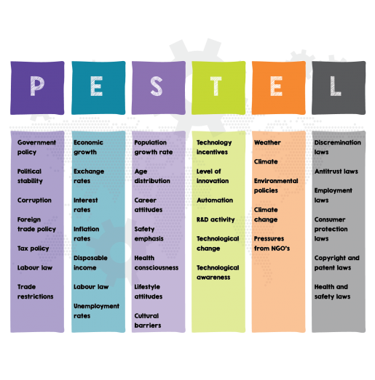
Macro Environment

Slide 13
Economic Environment
Economic environment comprises of all those economic factors that indirectly affect the business as the business has to keep in mind its economic constraints and system.
It includes:
Economic System ( Socialist, Capitalist or Mixed Economy)
Economic Condition (Inflation or Deflation)
Economic Growth
Economic Policies ( e.g.: Fiscal Policies, etc)
Exchange rates and interest rates

Slide 14
Socio-Cultural Environment
Social
It includes :
Social and class system
Religious beliefs
Linguistic Base
Racial diversity
Social evils
A business needs to be well versed with the socio-cultural environment because the socio-cultural environment decides the taste and preferences of the people and would create opportunities of threats for the business.

Slide 15
Socio-Cultural Environment
Demographic / Cultural
Demographic Environment includes:
Population of a country
Literacy Rate
Birth/Death rate
Age classes
Standard of living
A business needs to know its demographic environment well to tackle and meet its demand well and adjust itself according to the populations’ demand.

Slide 16
It is the most dynamic environment of the business since it keeps changing rapidly.
A business needs to promote innovation and needs to change itself with the changing technology to be able to compete well with the competition and take all the advantages over the competitors.
Technological Environment

Slide 17
Natural Environment
It includes:
Climatic Conditions
Topographical Features
Kind of Soil
Weather
Natural resources
A business needs to know its natural environment well in order to take advantage of its natural surroundings.

Slide 18
Political Environment
Political Environment comprises of :
Legislative: it is responsible for making laws
Executive: It implements laws
Judiciary: it enforces laws
A business needs to know its political environment well and has to abide by all the rules and laws of the land it functions on.

Slide 19
International Environment
It includes all the laws related to the Export and Import of commodities, various international policies, Bilateral Treaties, special exchange treaties between countries, international boundaries to trade, etc.
It is important for an export and import business to study the international environment well in order to survive and grow in the market.

Slide 20
Questions ?

